Slide 1


ZenSar Technologies
In Plant Training

Slide 2
In Plant Training
In Plant Training for students to enrich their knowledge on Software ,Hardware and Networking.
Provide them exposure in real time Industry Knowledge.
Trainers are delivering a relevant and guided learning skill that combines Lecture and practice to deliver what you need to know about a product or technology.

Slide 3

Objective of the Training
To enrich the student knowledge in :
->Hardware
->Networking
->Embedded systems
->Android Database
->Software Platforms

Slide 4

ZenSar Technologies Services
Analytics

Slide 5

ZenSar Technologies Services
Cloud and Infrastructure

Slide 6

ZenSar Technologies Services
Digital Experience

Slide 7
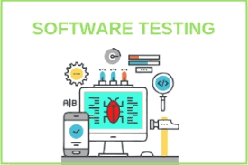
ZenSar Technologies
Software Testing

Slide 8
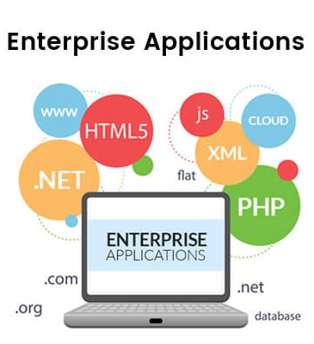
ZenSar Technologies
Enterprise Application

Slide 9
Overview of the Internship
Java and its applications.
MySql Database
Html ,XML.
Sql with Javascript.
Projects:
-> Gate Portal Form

Slide 10
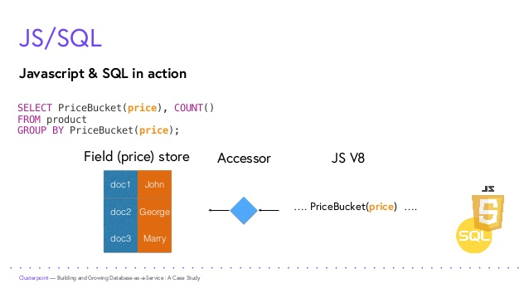

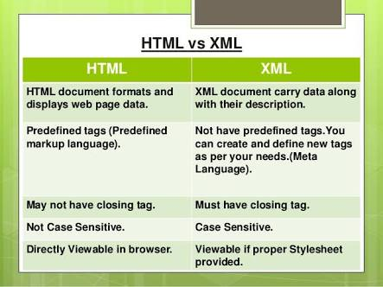

Slide 11
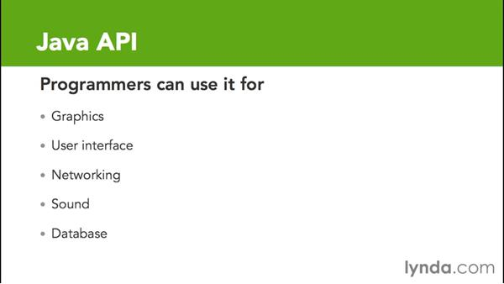

Slide 12
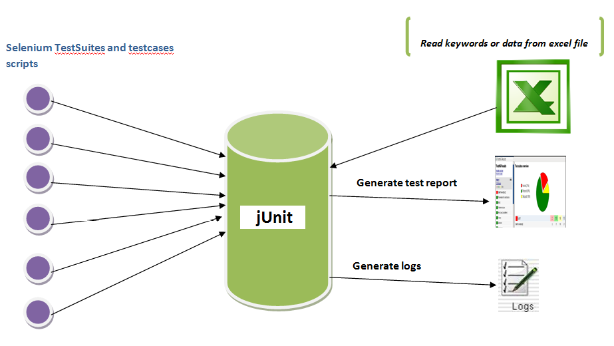

Slide 13
Challenges and Achievement
Challenges
Professional Environment
New Technology
Requirements
Achievement
Java, Java API
Junit(Test cases)
Data structures in Java
MySql Database

Slide 14
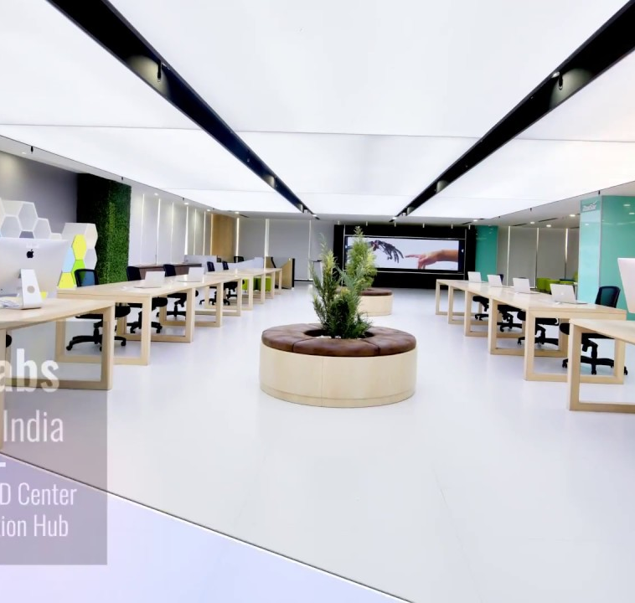
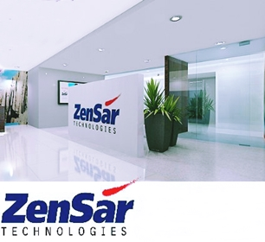
Conclusion
Industrial Training program in ZenSar Technologie had given opportunities to trainee to prepare themselves as future IT experts.
ZenSar Technologies has a lot of dedicated employees who are willing to help to make this industrial training program a success.
Well delivered the final project and give benefits to the Host Company supervisor and manager.

